Slide 1
Smart City Traffic & Air Quality Insights
Analyzing traffic congestion and pollution patterns for smarter urban planning
Name: Tanmay Sharma
Date: 2025-09-21

Slide 2
Problem Statement:
Current challenges in urban cities:
🚗 Traffic congestion
🌫️ Rising air pollution
📍 Identifying hotspots for better planning
Objective of this dashboard → “To monitor traffic & pollution trends, highlight hotspots, and support data-driven city planning.”

Slide 3
Data Overview
Source: Synthetic traffic & air quality dataset (BigQuery → Power BI)
Key fields: Location, VehicleCount, PM2.5, PM10, NO2, Temperature, Humidity, Time, Date
Scope: 5 city locations (Elm St, Main St, Park Ave, 5th Ave, Broadway)

Slide 4
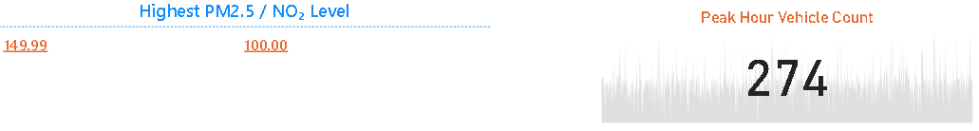
Key KPIs
KPI Cards:
🚗 Peak Hour Vehicle Count
🌫️ Highest PM2.5 / NO₂ Level
📍 Most Congested Location

Slide 5
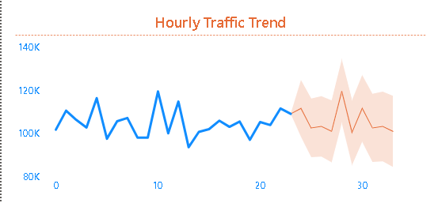
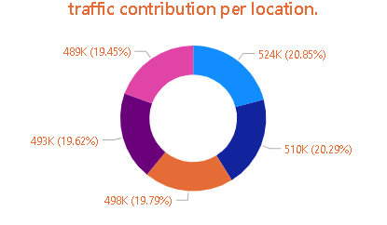
Hourly Traffic Trends
Line chart (Hourly Vehicle Count trend)
Insight: When is the traffic peaking (rush hours)?
Traffic Contribution per Location
Donut chart(Vehicle distribution across locations)
Insight: Which areas contribute most to congestion?

Slide 6
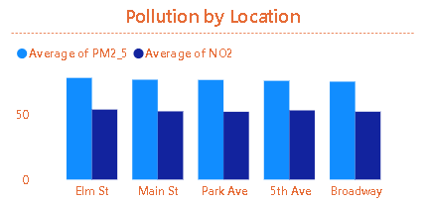
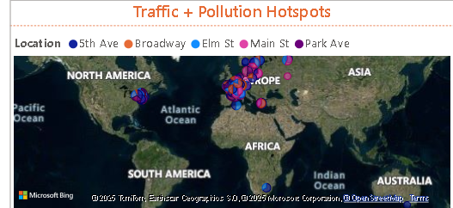
Pollution Insights
Bar chart comparing PM2.5 vs NO₂ by Location
Insight: Which areas are pollution hotspots?
Geo Hotspots Map
Map visualization with bubble size = traffic count, color = pollution level
Insight: Hotspot areas (high congestion + pollution overlap)

Slide 7
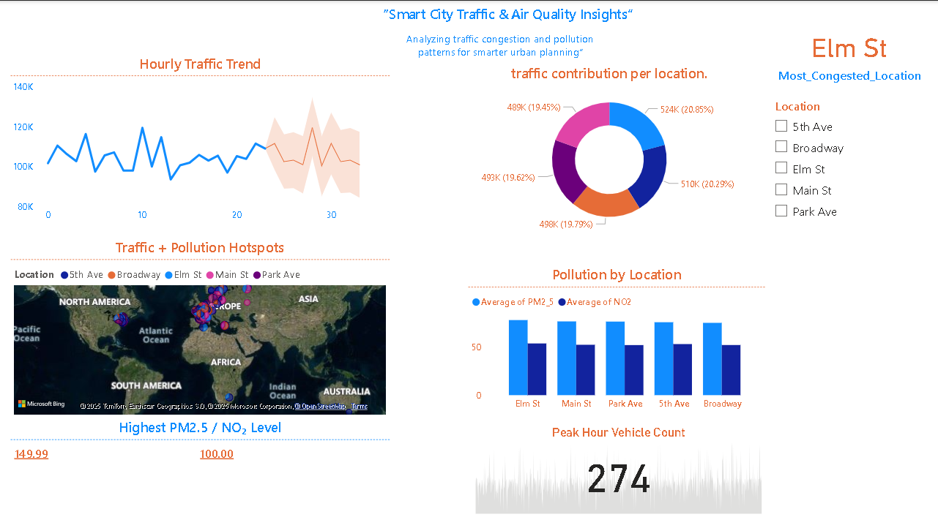
Dashboard:

Slide 8
Recommendations :
📍 Target high-traffic hotspots (Elm St, Main St) with congestion control measures
🌫️ Pollution monitoring for high PM2.5 zones
🚦 Suggestion: Smart signals, EV promotion, alternate routes

Slide 9
Thank You:
LinkedIn:
Git hub:

